Slide 1
CSE322
Acceptance by Pushdown Automata
Lecture #31

Slide 2
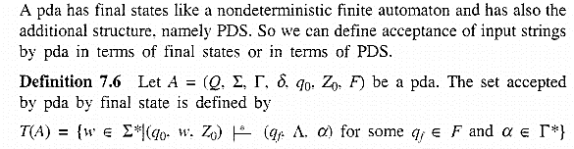

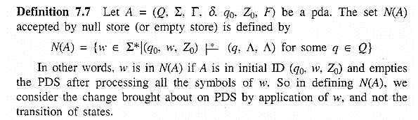
Acceptance by PDA
Example

Slide 3
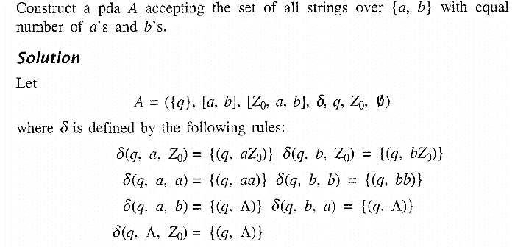
Example

